Slide 1
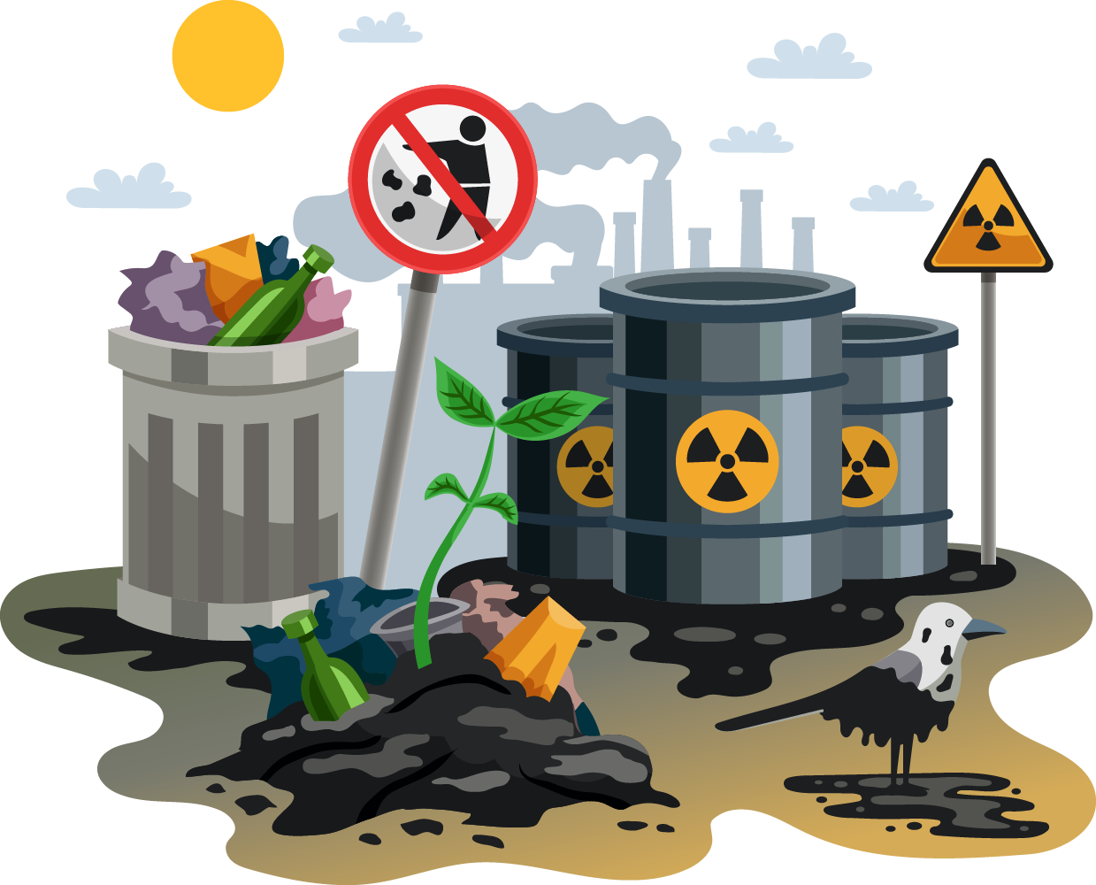


Exide DTSC Clean-Up Project
Addressing Environmental and Health Challenges caused due to Exide battery company in Vernon, California

Slide 2




PROJECT OVERVIEW
Problem
Issues
Objective
Environmental contamination caused by the Exide battery recycling plant
Health risks for nearby communities.
Release of harmful levels of lead and arsenic
Systematically clean affected areas, restore environmental safety, and build community trust

Slide 3


PROJECT GOALS
Comprehensive Cleanup Efforts
Community Engagement
Remediation of 5,333 parcels (up to 14 feet of soil excavation)
Community engagement (public meetings, local workforce training)
Workforce Development
Strategic Partnerships
Training over 70 residents through the DTSC Workforce for Environmental Restoration in Communities program.
Collaboration with EPA and CalEPA for funding and resources.

Slide 4





Project Approach
SOIL SAMPLING
Identification of contamination levels.
REMEDIATION PLANNING
Tailored cleanup strategies.
TRANSPARENCY AND MONITORING
Continuous oversight of contractor performance by DTSC staff
EXECUTION OF CLEANUP
Soil excavation, contamination removal.

Slide 5
SCRUM IMPLEMENTATION
Sprint 1 (Weeks 1-2)
SPRINTS
1
Initial discussions, project requirements gathering, and issue selection. The team identified the need for transparency tools and proposed a Software application for real-time updates.
Sprint 2 (Weeks 3-4)
2
Soil sampling in priority areas and confirmation of technology stacks (React . js for the front end, Node.js for the back end). Initial designs for the user interface were developed.
Sprint 3 (Weeks 5-6)
3
Execution of cleanup plans, including data visualization for contamination reports. Legal and environmental datasets were integrated into the platform.
Sprint 4 (Weeks 7-8)
4
Monitoring and progress updates, incorporating stakeholder feedback into the UX/UI design. Testing of the platform and adjustments to improve scalability and performance.

Slide 6
SCRUM IMPLEMENTATION
SPRINTS
Sprint 5 (Weeks 10-11)
5
Finalizing the platform for public beta launch and preparing documentation for project handoff. Office hours in local communities were established to answer resident queries.
Sprint 6 (Weeks 12)
6
Comprehensive system testing and validation were completed. Feedback from public testing was incorporated into the design, enhancing the environmental mapping feature.
Sprint 7 (Weeks 13)
7
The project concluded with successful deployment of all planned deliverables. Operational documentation was finalized, and a knowledge transfer session was conducted for stakeholders.

Slide 7




Product Owner - (Krishnavyas Desugari) Project Manager - (Visnupiriyan Kumarraja) Scrum Master - (Avinash Mandalapu) Business Analyst - (Shinny Porwal) Developer - (Doranaga Sainadh Vanama) Developer - (Rithika Goud Pabathi) Security Expert - (Shoaeb Nawab Shaik) Content Manager - (Vimalesh Boorle)
ROLES & TEAM MEMBERS

Slide 8

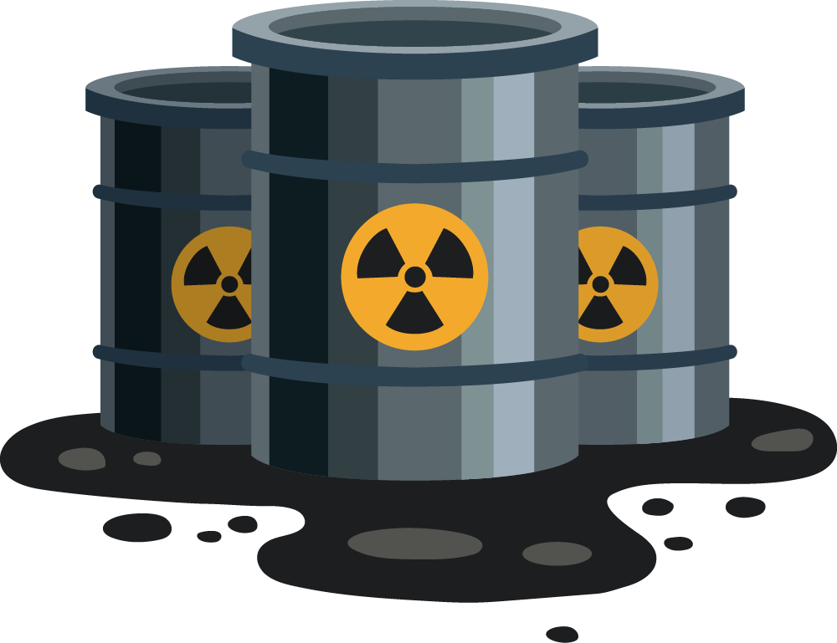

DELIVERABLES
 | Key Project Outcomes
Environmental Cleanup | 5,333 parcels remediated, including homes, schools, parks, and daycares.
Application Features | Provides real-time updates on spill locations via Maps. | Monitors work progress by employees and vendors.
Community Workforce Development | Trained 70+ residents for environmental restoration tasks.
Sustainability | Transparent tools and processes for ongoing monitoring. | Clear documentation for regulatory oversight and community awareness

Slide 9
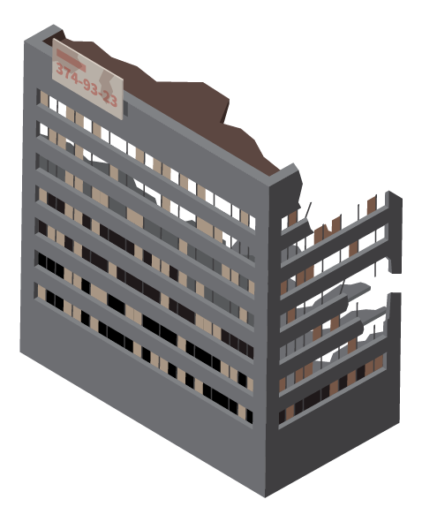
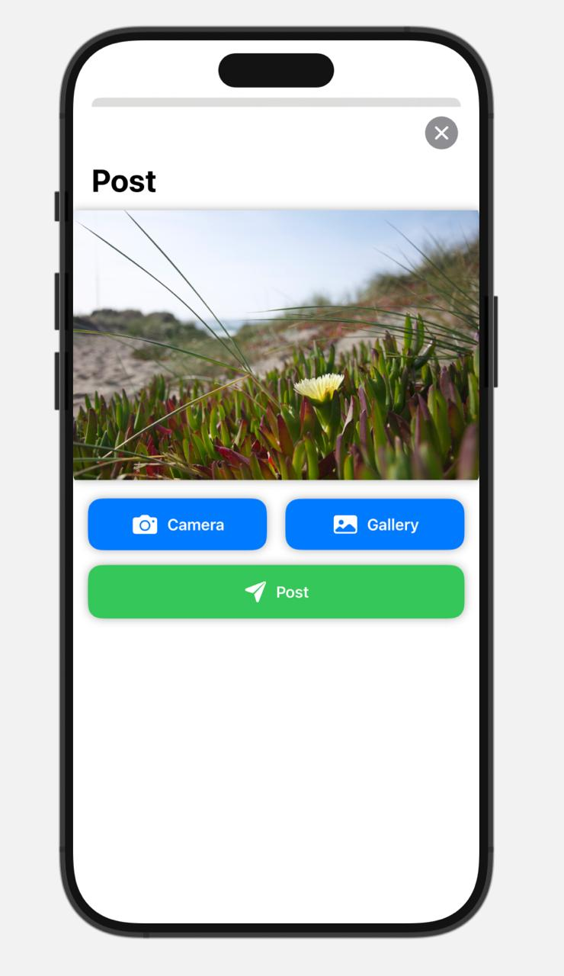
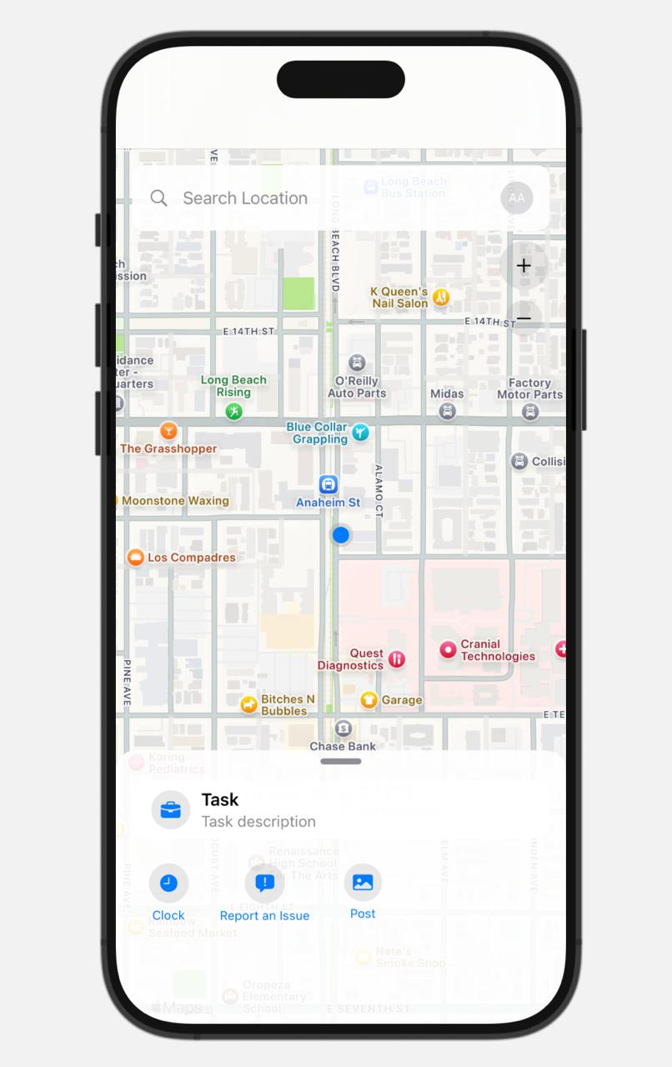
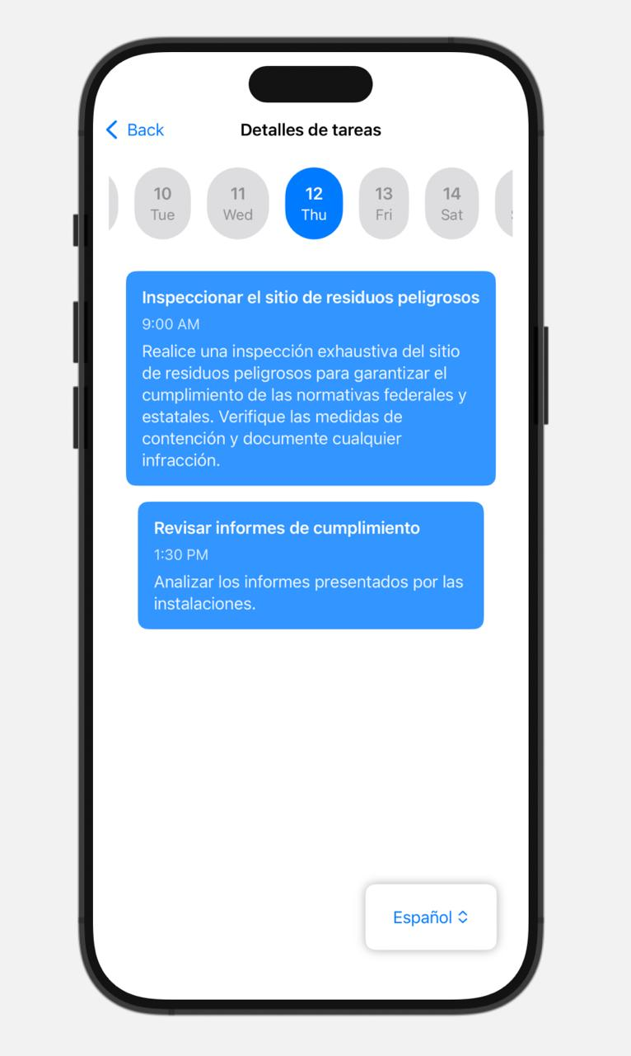
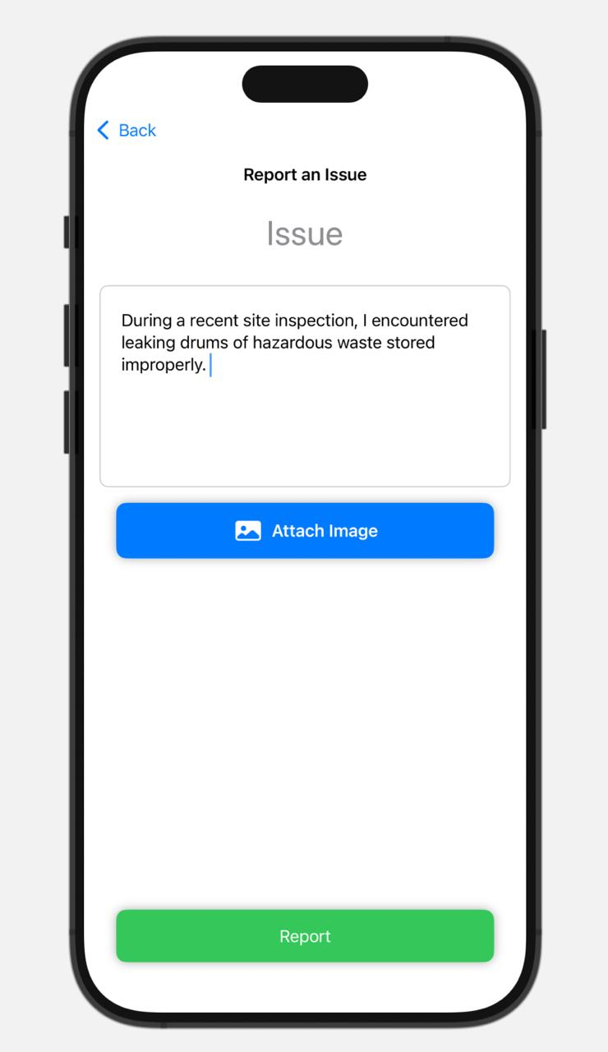
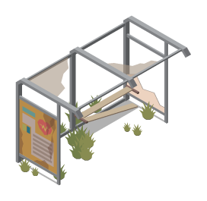

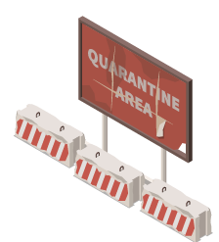

USER AND VENDOR APPLICATION

Slide 10
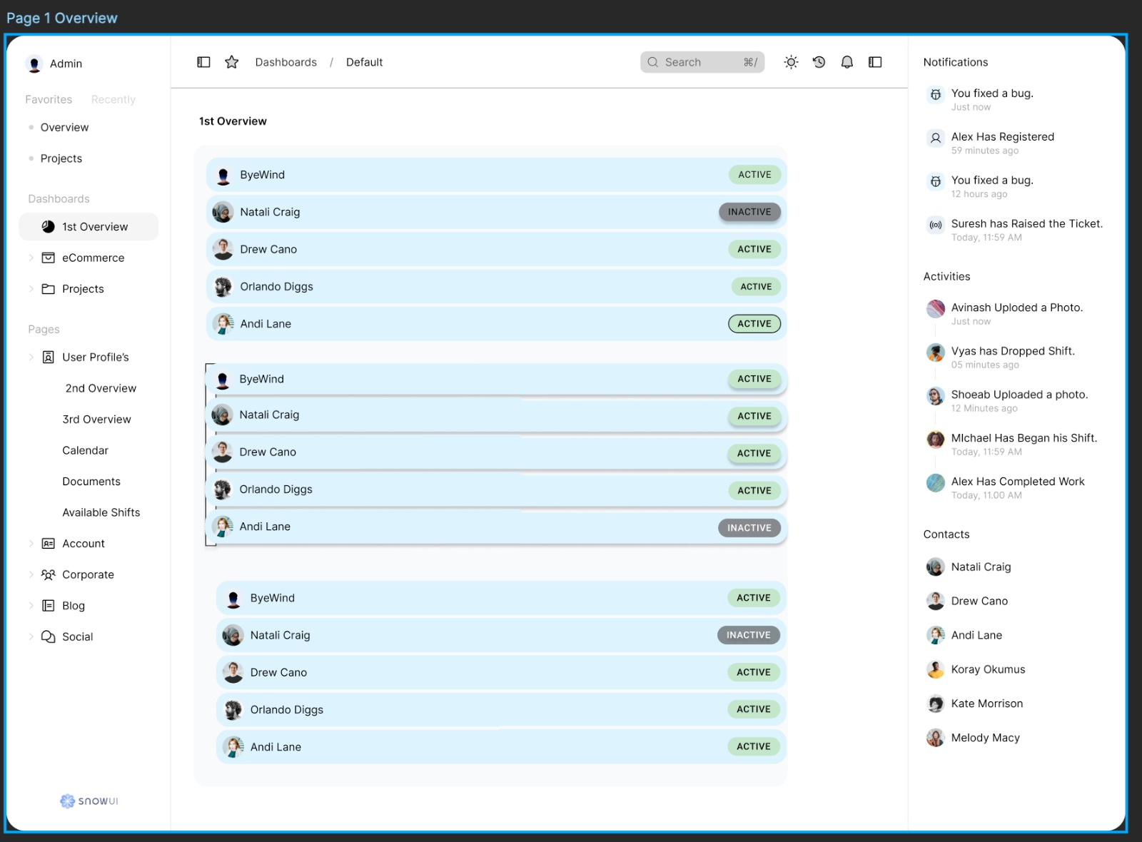
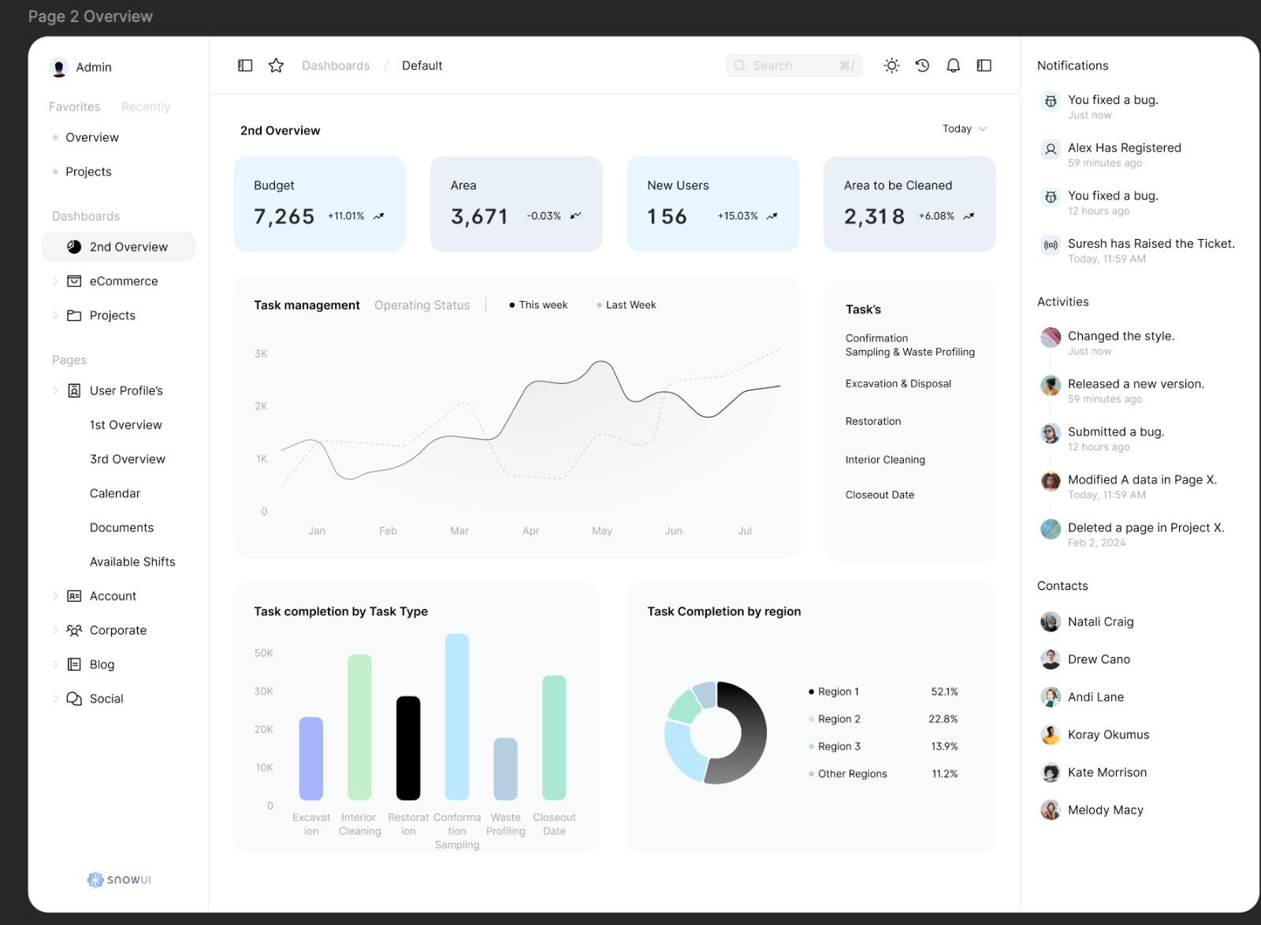
ADMIN INTERFACE

Slide 11
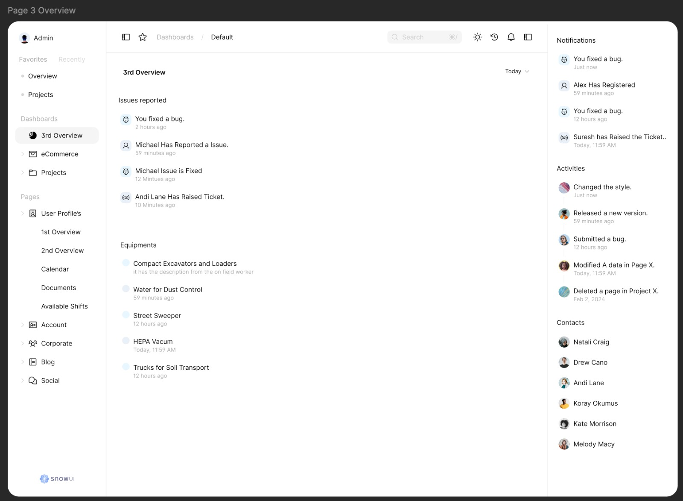
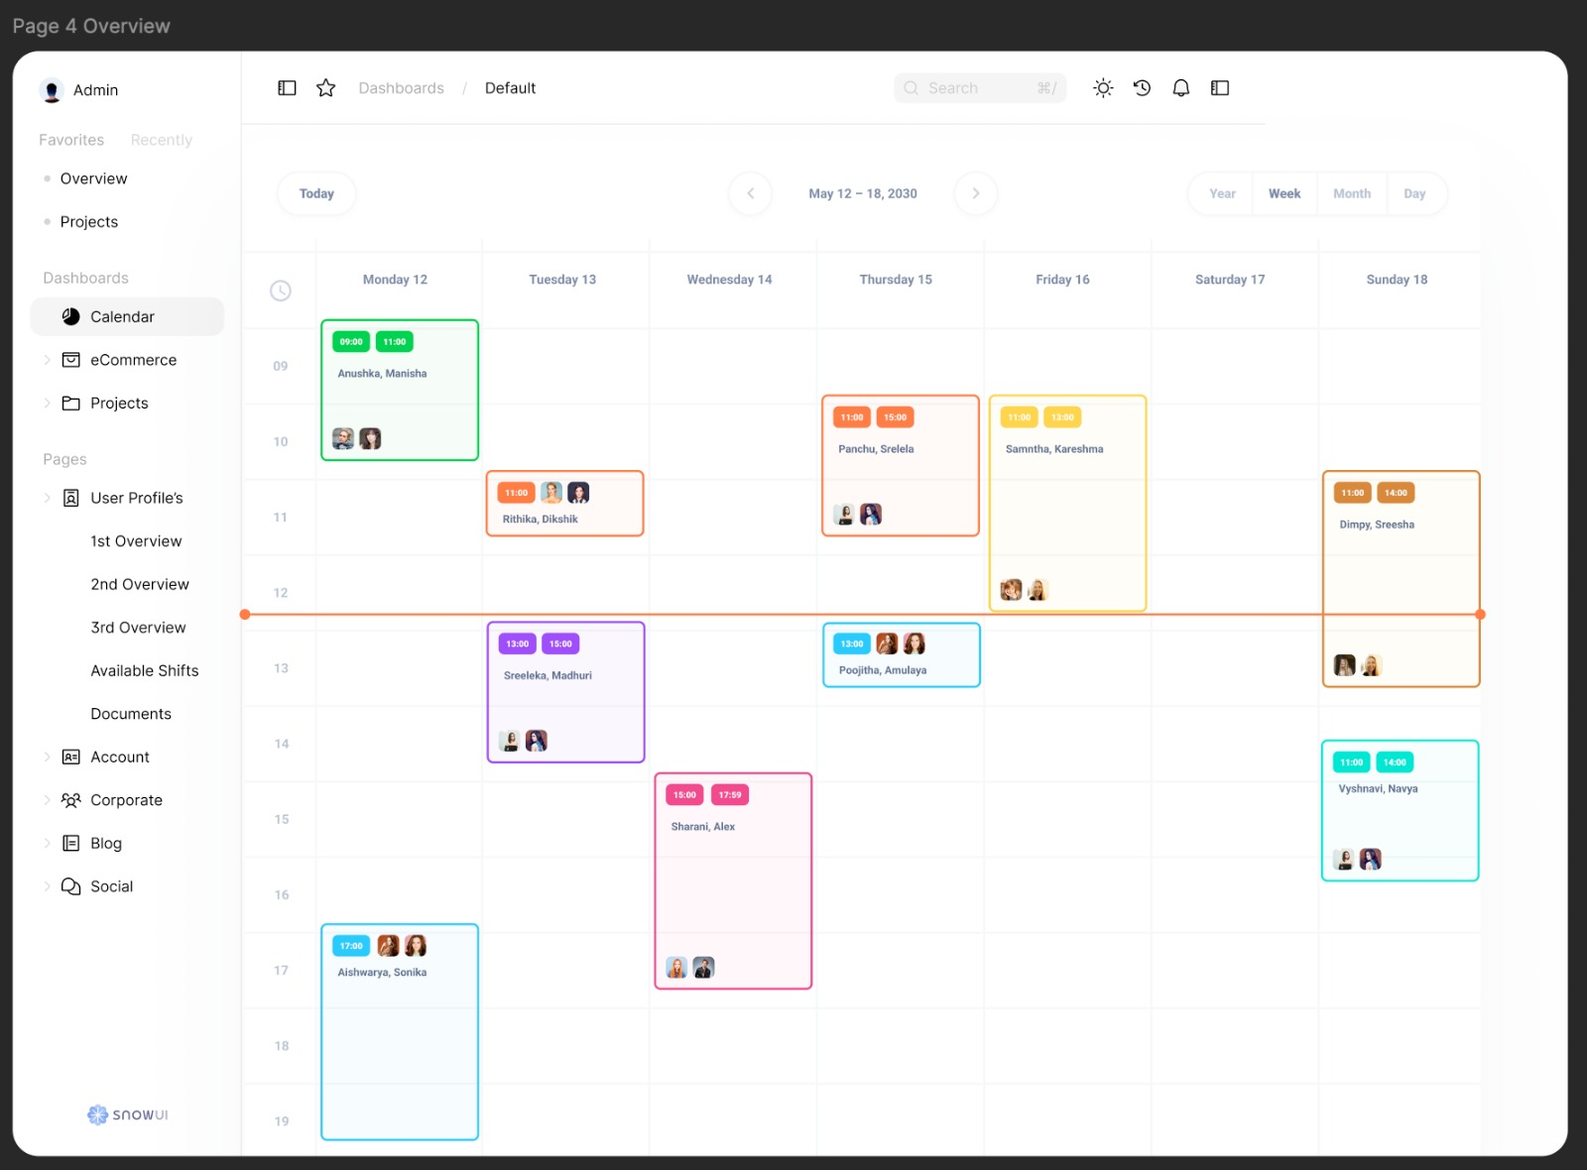
ADMIN INTERFACE

Slide 12
CHALLENGES AND SOLUTIONS
Community Non-Compliance
Depth of Contamination
Funding Constraints
Data Delays
Community Education Campaigns
Advanced Remediation Techniques
Securing Federal Resources
Streamlined Processes

Slide 13
Community Engagement
Interactive Application
Communication
Enabled real-time tracking of cleanup and contamination data .
Facilitated communication between community members, vendors, and officials.
Local Workforce Training
Public Meetings
Residents employed and trained through DTSC's workforce program.
Regular updates and discussions on cleanup progress. Addressed community concerns transparently.

Slide 14



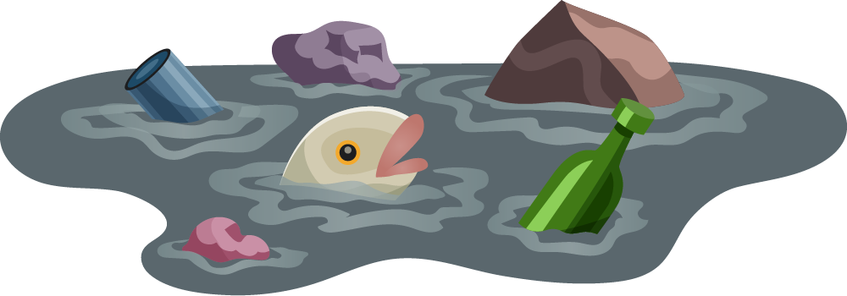

Future Steps
Federal Superfund Designation
Monitoring and Maintenance
Secure ongoing federal funding for future cleanup efforts
Office Hours in Affected Communities
Open channels for questions and concerns in Huntington Park and Commerce.
Regular soil testing and reporting to ensure long-term safety

Slide 15
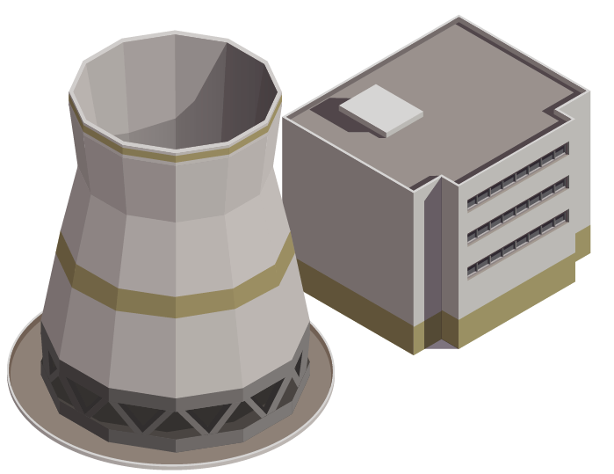

Conclusion
The Exide DTSC Project exemplifies a collaborative and innovative approach to addressing environmental hazards in impacted communities.
Through a combination of rigorous remediation efforts, community engagement, and technological advancements, the project has achieved significant milestones, the introduction of an application to enhance transparency and efficiency.

Slide 16
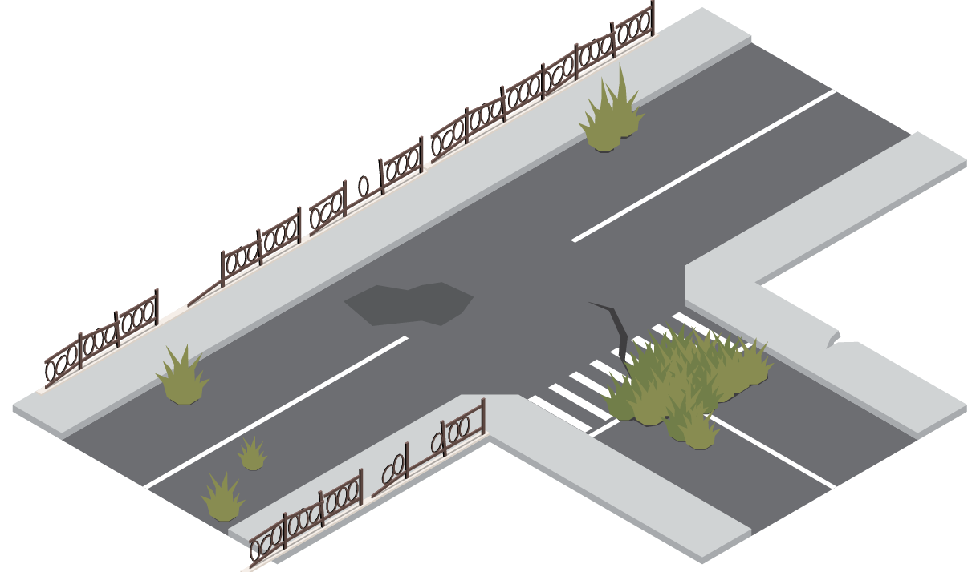






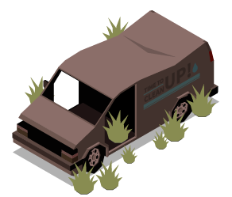





Thanks You All!

